Slide 1
THE OUTSIDERS
A BOOK CLUB PRESENTATION BY LAMARCUS WANNER
BY S.E. HINTON

Slide 2
Summary
Ponyboy and his two brothers Darrel (Darry), who is 20 and Sodapop who is 16 lost their parents in a car accident. The boys are greasers, a class term that refers to the young teens on the East Side, the poor side of town. The greasers' rivals are the Socs short for Socials, who are the "West-side rich kids.” After Ponyboy and Johnny get in a fight with some socs Johnny accidently kills one of the more popular socs Bob they go on the run Dally a fellow greaser supplies them with a location to hide, some money, and gun. They hide in a empty church until it burns down Johnny gets serious burns and dies theres a big fight in a empty lot greasers and Shepard's gang vs Socs. Dally goes crazy robs a store that’s when the police shoot him down.

Slide 3
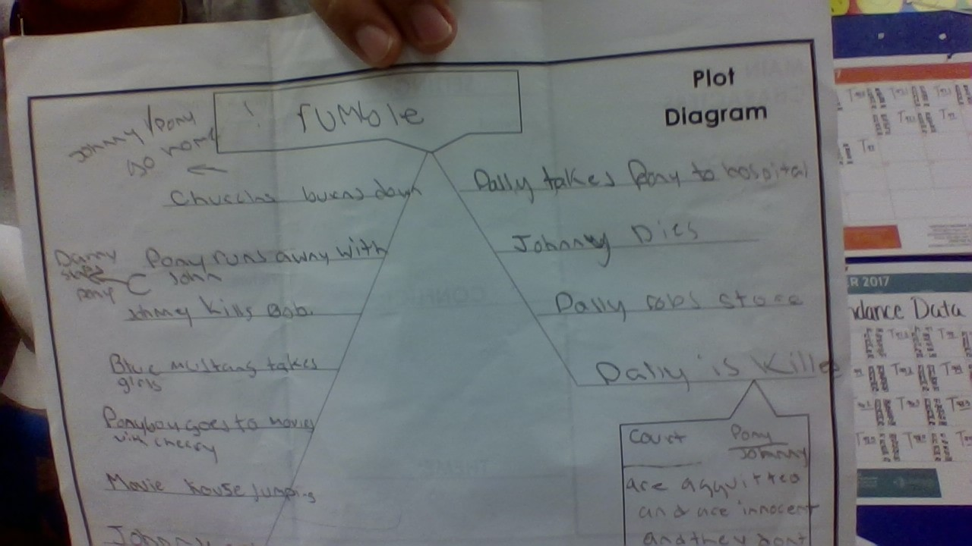

Slide 4
setting
Time period-1960’s
Description- Oklahoma City (eastside)
Tone-serious

Slide 5
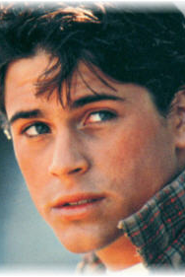
Main character-Ponyboy
Traits- fourteen-year-old narrator and protagonist, and the youngest of the greasers Ponyboy’s literary interests and academic accomplishments set him apart from the rest of his gang. Because his parents have died in a car accident, Ponyboy lives with his brothers Darry and Sodapop. Ponyboy is a reliable and observant narrator. Throughout the novel, Ponyboy struggles with class division, violence, innocence, and familial love. He matures over the course of the novel, eventually realizing the importance of strength in the face of conflict.

Slide 6
Main conflict
THE
Against the background of the clash between the poor greasers and the rich Socs, the greaser Ponyboy struggles to mature. rising action. Johnny kills a Soc; Johnny and Ponyboy flee; tension mounts between the greasers and Soc.

Slide 7
THEME:1
Bridging the gap between rich and poor- In the book in chapter 2 and 3 Cherry and Pony compare greasers and socs and how their not that different.

Slide 8
Theme:2
honor among the lawless- They talk how we see acts of honorable duty from Dally Winston, a character who is primarily defined by his delinquency and lack of refinement.

Slide 9
Theme:3
the treacherousness of male-female interactions-As hostile and dangerous as the greaser-Soc rivalry becomes, the boys from each group have the comfort of knowing how their male friends will react to their male enemies. When Randy and Bob approach Ponyboy and Johnny, everyone involved knows to expect a fight of some sort. It is only when Cherry and Marcia of the Soc contingent start to act friendly toward the greasers that’s what causes the true trouble . Even on the greaser side, Sodapop discovers female distrustfulness when he finds out that his girlfriend is pregnant with another man’s child.

Slide 10
Comparing novel to another book
outsiders
Summer in a day
They main character and greasers are picked on by soc’s.
The protagonist is looked at as a bad person (underdog)
Humans are picked on by rocket people.
The protagonist is viewed as the underdog.

Slide 11
Most impactful signpost
When ponyboy realizes Darry really loves him it really shows the power of brotherhood.

Slide 12
Conclusion
. The climax is when Johnny passes away after saving children from a church engulfed in flames. Dally feels life is pointless so he lets cops kill him. Pony struggles with his understanding of the deaths that have happened.

